Slide 1
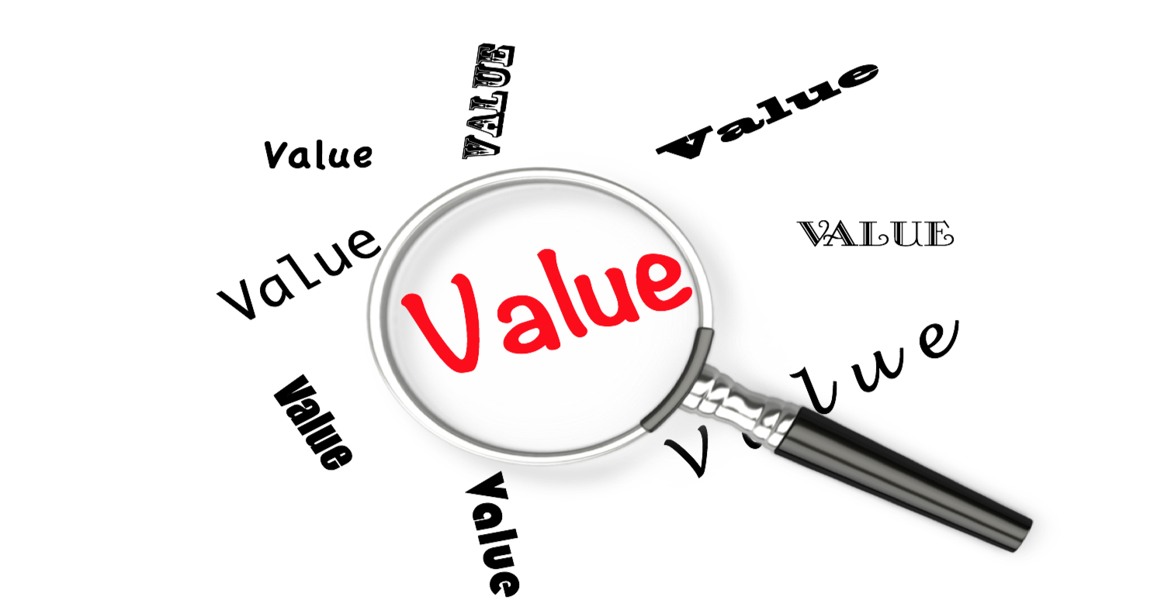
Our Value Systems
We all have one
What is a value system?

Slide 2
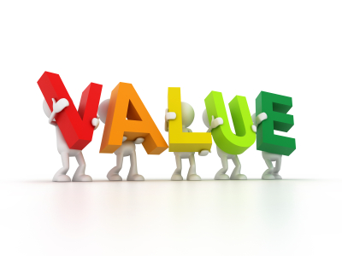
Value System Defined
How we place values (emphasis & importance) on various things
Not always deliberate or intentional
Not always set by what we say or orally teach
Not always set by what hear in class or sermon
Subtle
Unintentional setting of values by decisions made
May set a value that we would never say to or teach our children – but instill it anyway

Slide 3
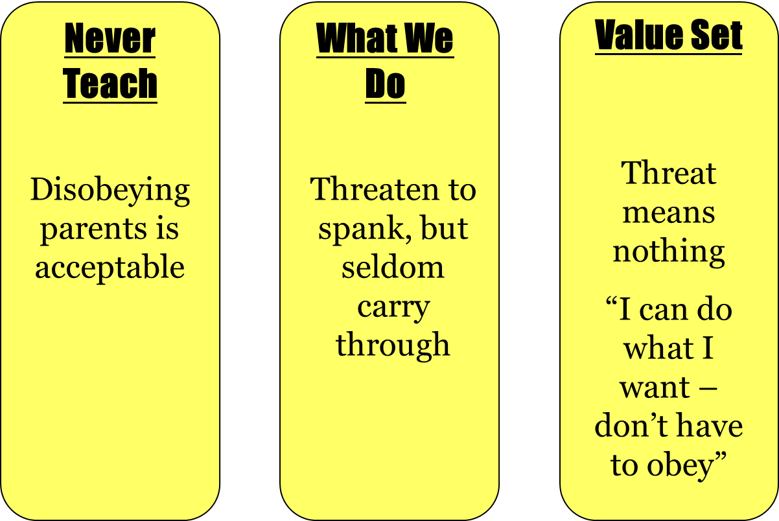
How It Works

Slide 4

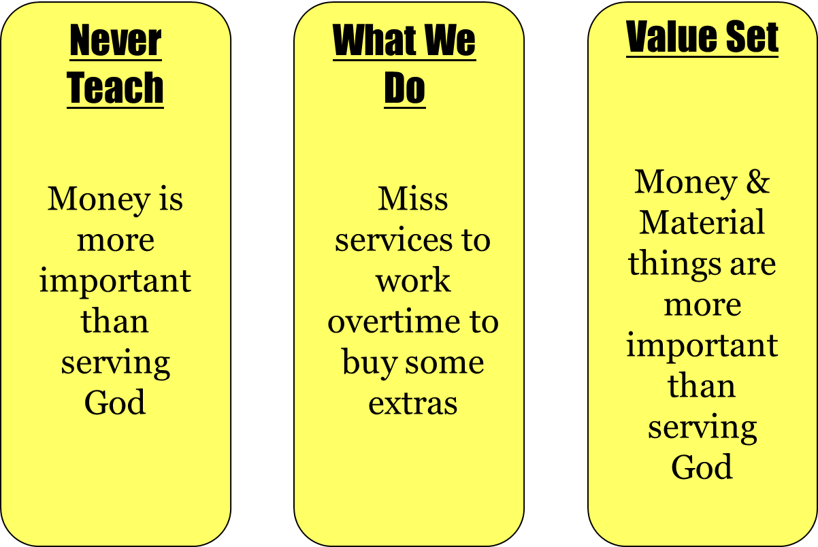
How it Works

Slide 5
Who Is Affected?
Self - (By wrong choices)
Children - (Their values – set)
Others – (Learn from your actions)
Don’t Be Surprised When Your Children Follow
the Value System Set For Them!

Slide 6
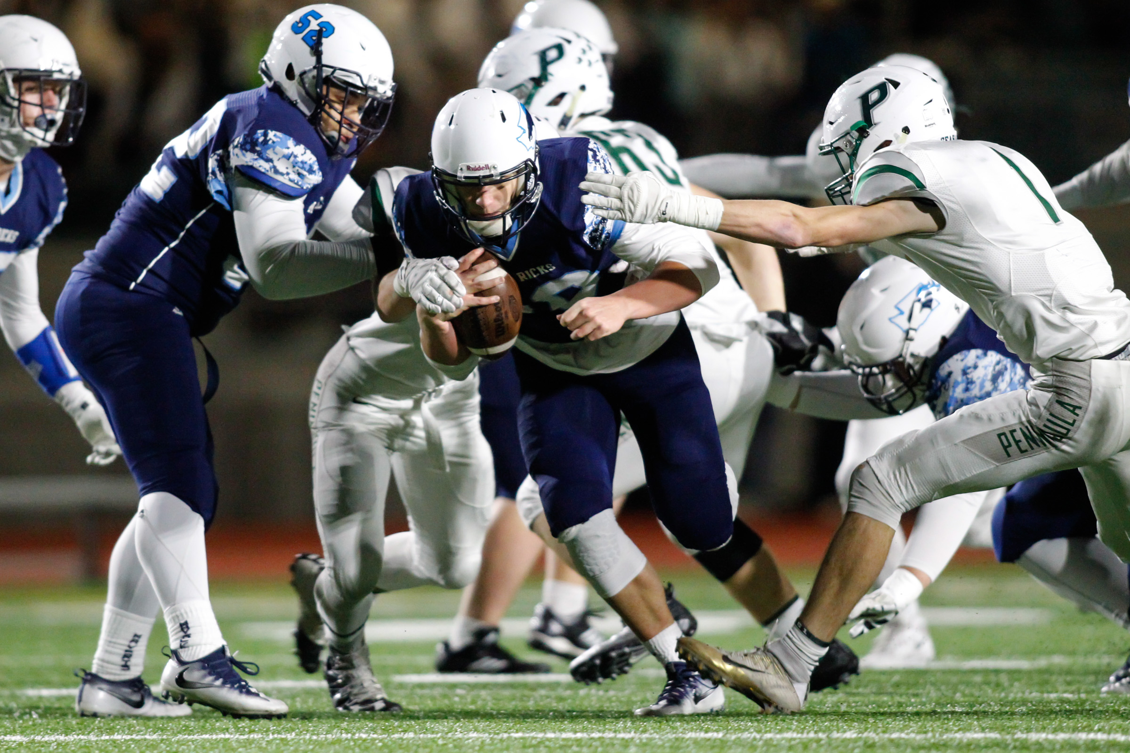
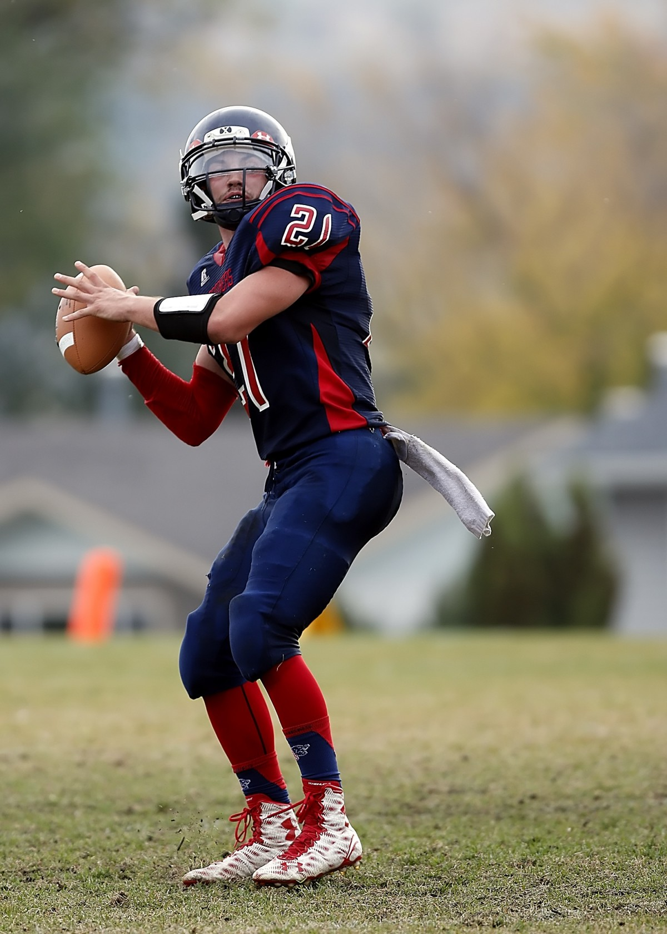
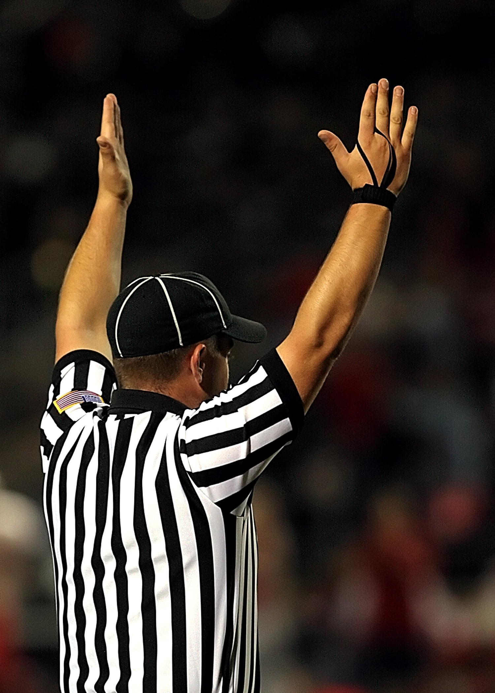
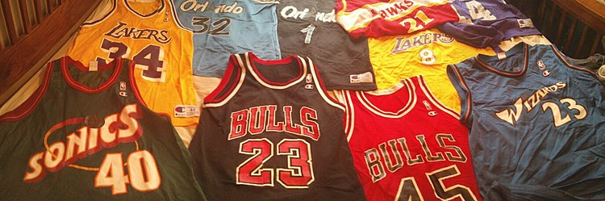
Sometimes We Send a Different Signal
Than We Intended!
Woman who wanted her three boys to become preachers…
Couldn’t understand why all three became “coaches” instead
Conversation around kitchen table – about sports
Went to all Games
Encouraged to play
Husband Official
Many Team Jerseys

Slide 7


I. The Power of Value Systems

Slide 8
I. The Power of Value Systems
A. Led family to the Lord (1 Peter 3:1-6)
B. Influence others to do wrong (Galatians 2:11-14)
C. Others read and learn (2 Corinthians 3:2-3)
D. Children become just like parents – even go farther (Ezekiel 16:44; Proverbs 20:7)
E. Like leaven – silent force (1 Corinthians 5:6; Matthew 13:33)
“Actions speak louder than words”

Slide 9
I. The Power of Value Systems
II. The Settings of the Value Systems

Slide 10

II. The Setting of Value Systems
Taught in Bible Class
Taught in Sermons
Sit down and teach
Tell them is right
N
O
T

Slide 11
II. The Setting of Value Systems
A. Example We Set (1 Timothy 4:12)
  Despite what we may say
  Someone is watching you
B. Decisions We Make (Proverbs 12:26)
  About career, school, friends
  For self, our children
C. Things We Allow (Judges 14)
  May not approve – even say it is wrong
  Allow children to do
  What we allow: miss, go, see

Slide 12
I. The Power of Value Systems
II. The Settings of the Value Systems
III. The Identity of Value Systems

Slide 13
III. The Identity of Value Systems
A. Missing services

Slide 14
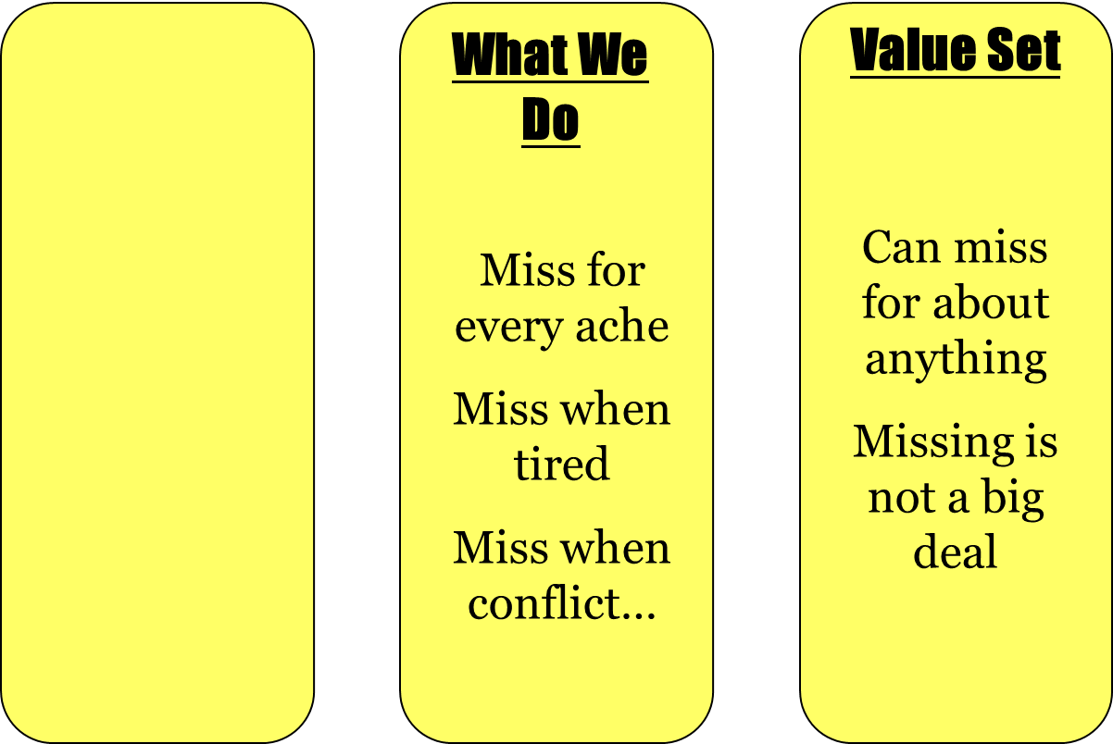
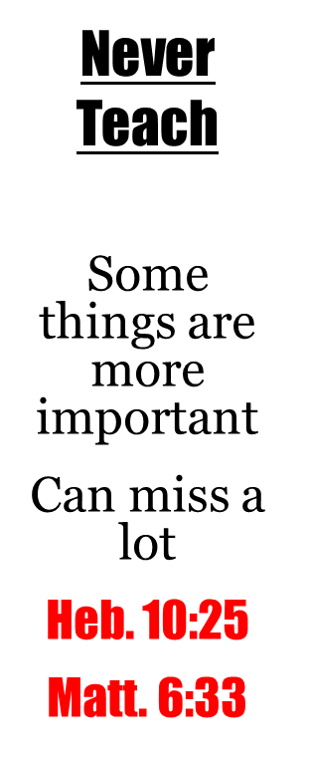
Missing Services

Slide 15
III. The Identity of Value Systems
A. Missing services
B. Sin

Slide 16
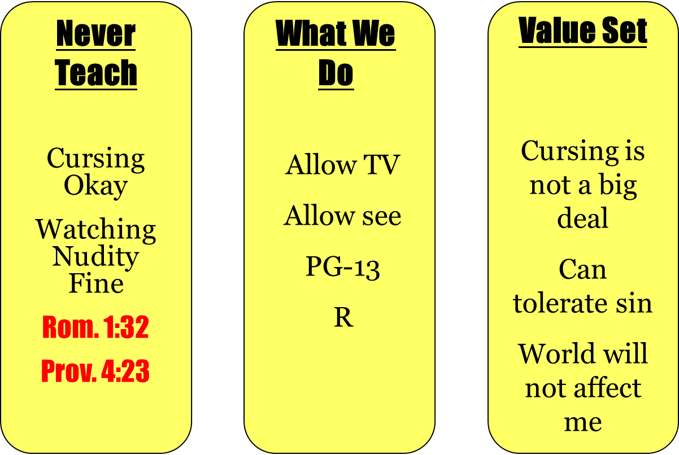
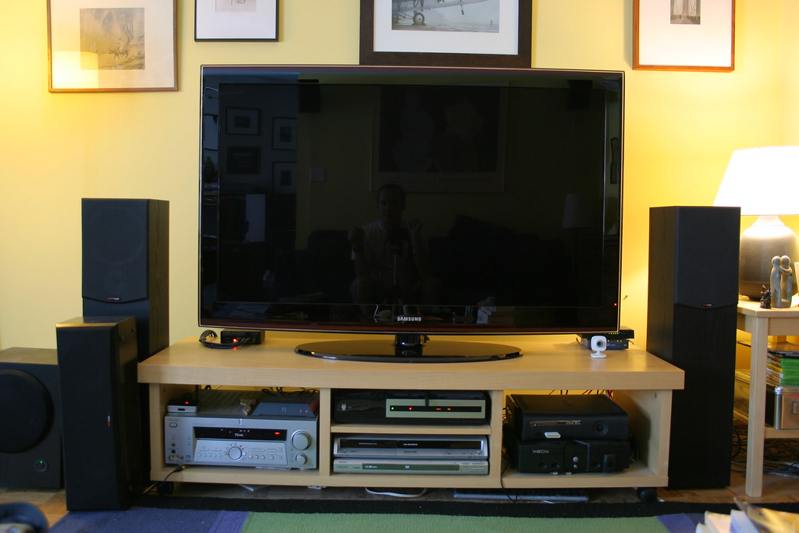
Sin
This Photo by Unknown Author is licensed under CC BY-NC

Slide 17
III. The Identity of Value Systems
A. Missing services
B. Sin
C. Bible study

Slide 18
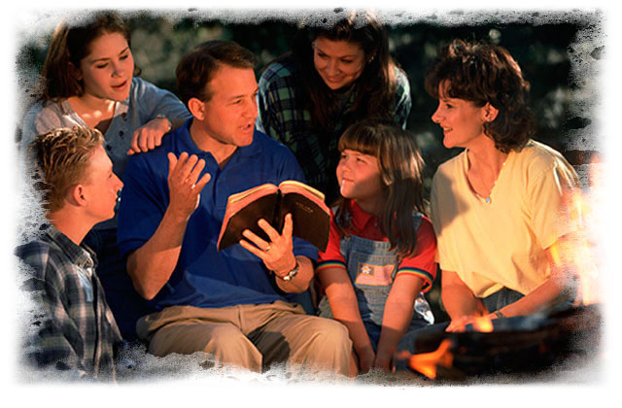
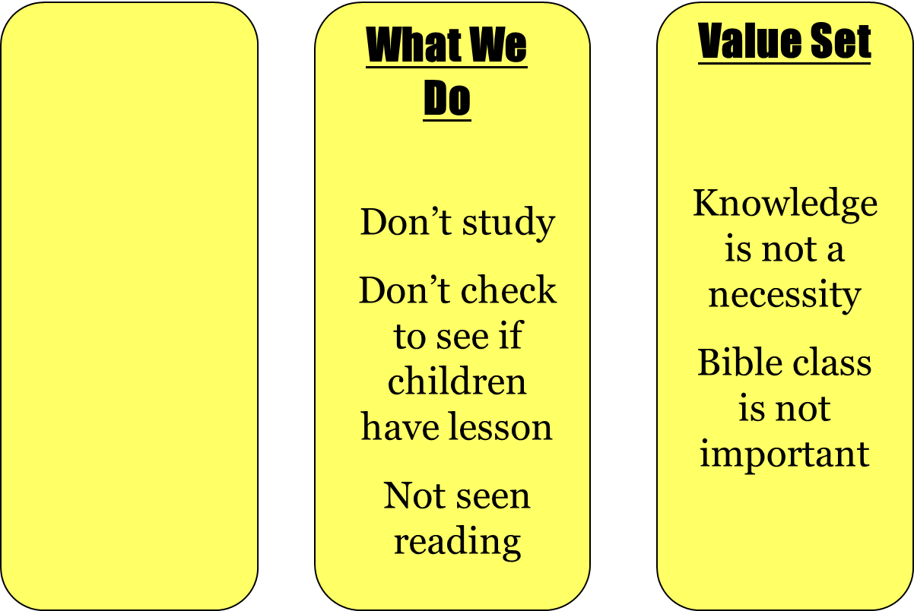

Bible Study

Slide 19
III. The Identity of Value Systems
A. Missing services
B. Sin
C. Bible study
D. Priorities

Slide 20

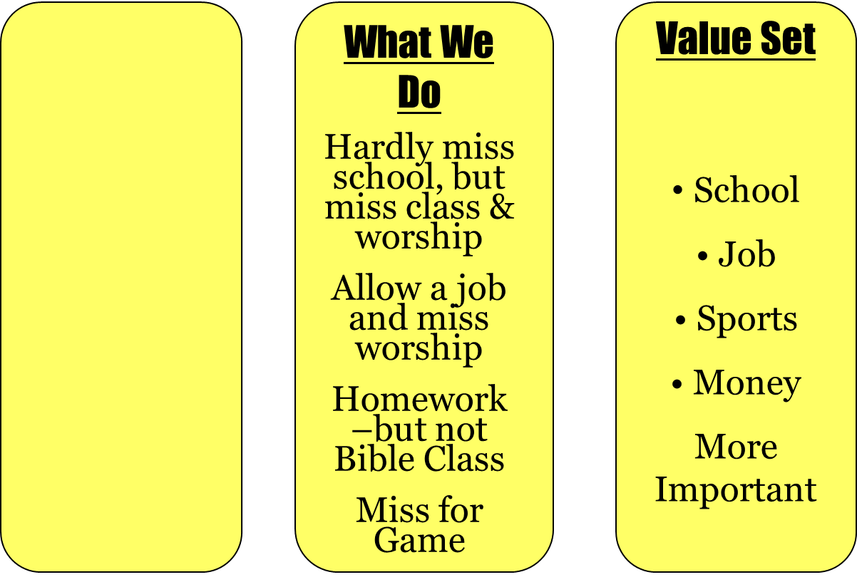
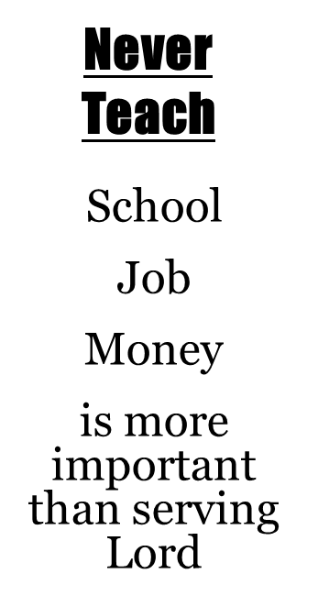
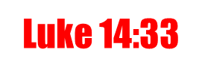
Priorities

Slide 21
III. The Identity of Value Systems
A. Missing services
B. Sin
C. Bible study
D. Priorities
E. Associations

Slide 22
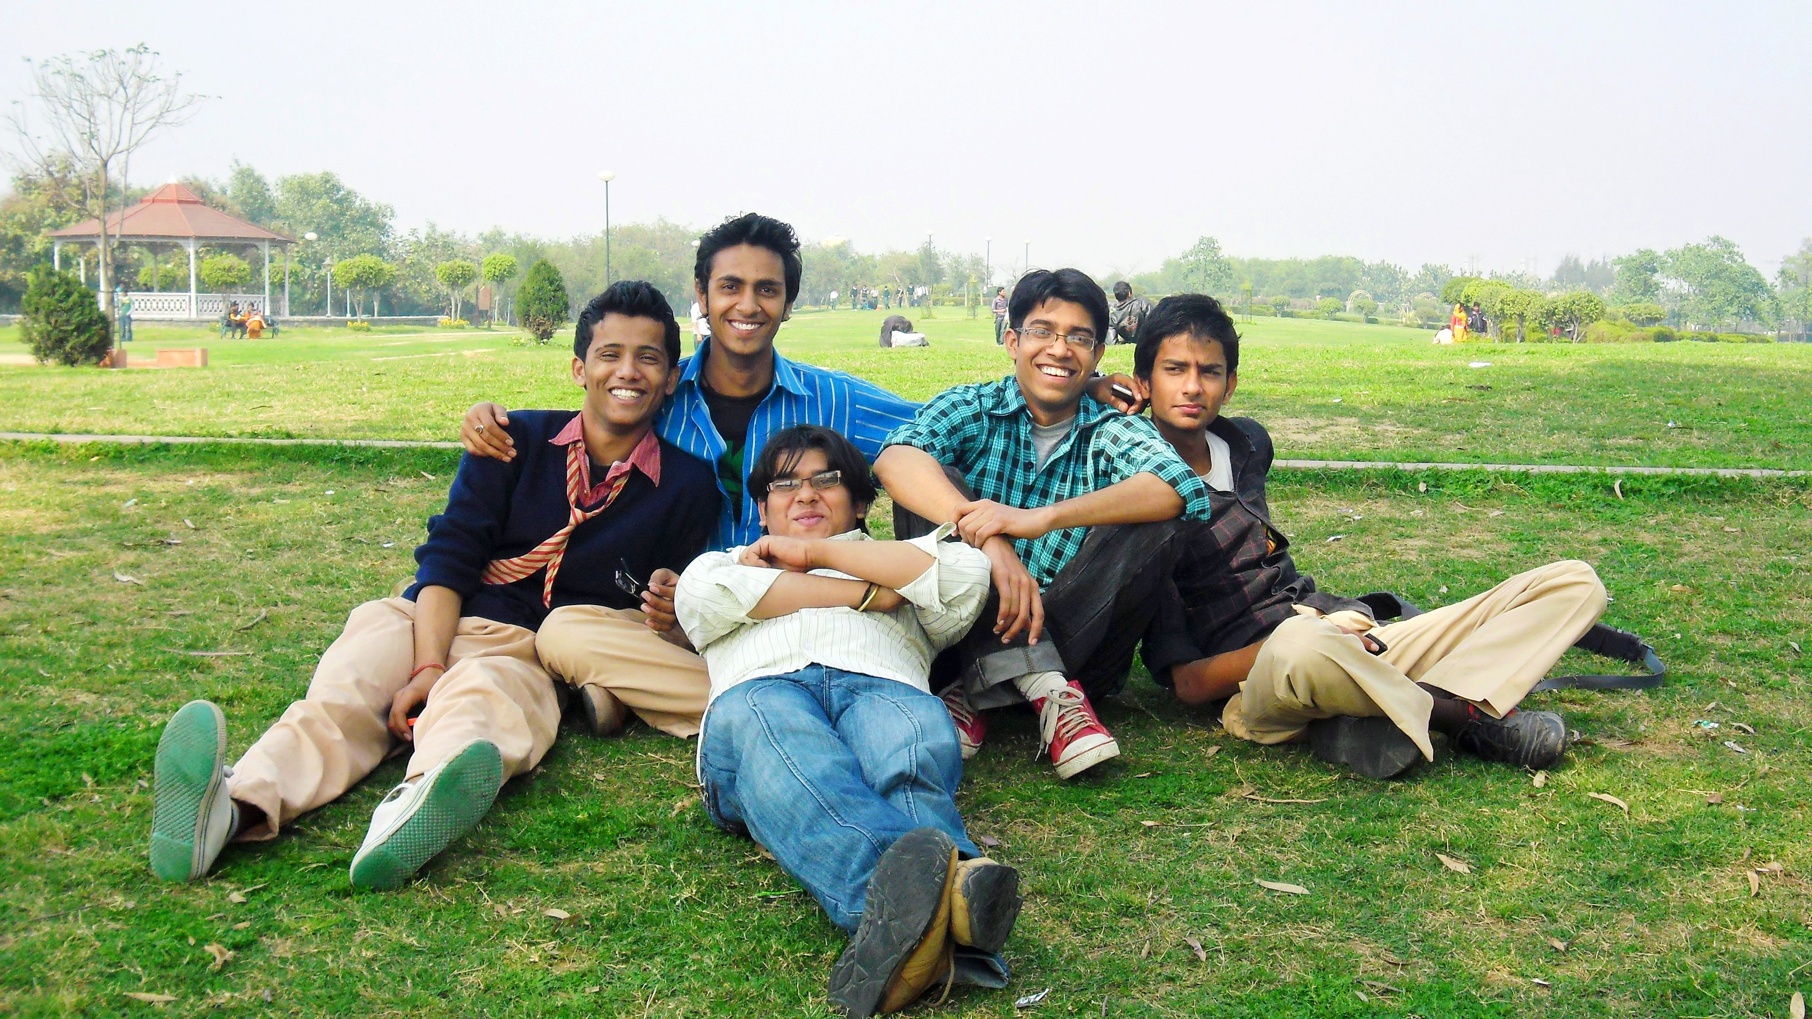
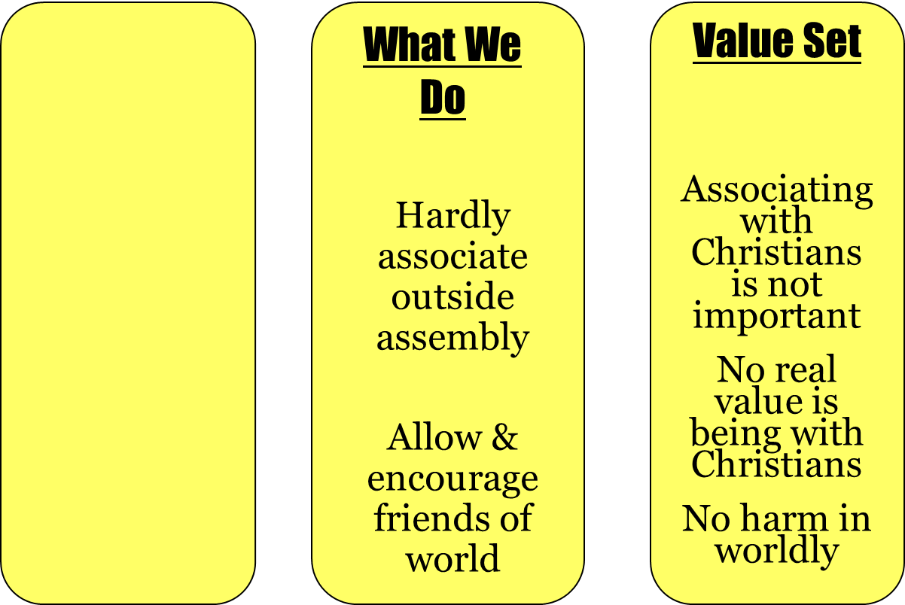
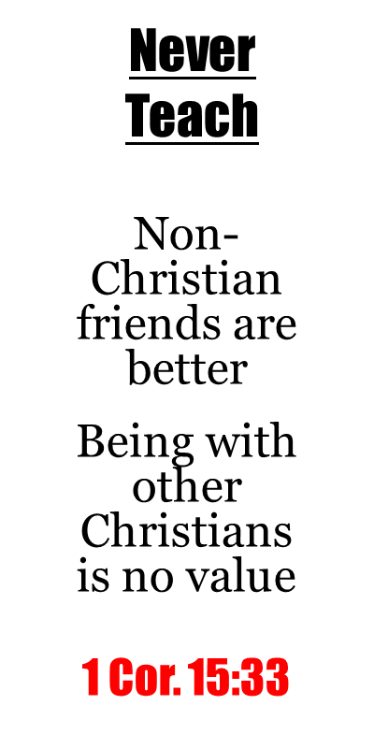
Associations

Slide 23
III. The Identity of Value Systems
A. Missing services
B. Sin
C. Bible study
D. Priorities
E. Associations
F. Home/ Family

Slide 24
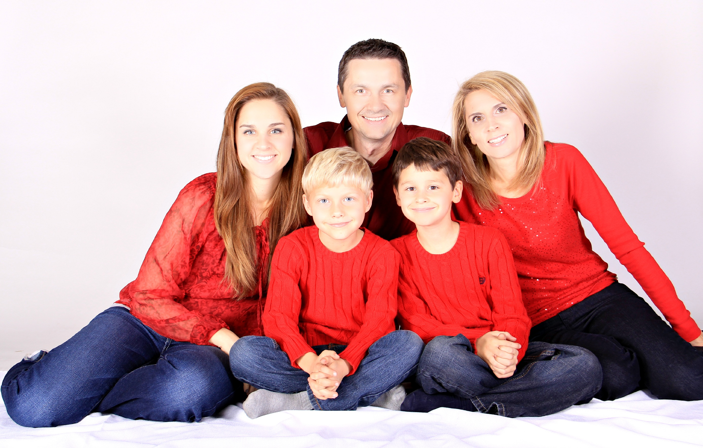
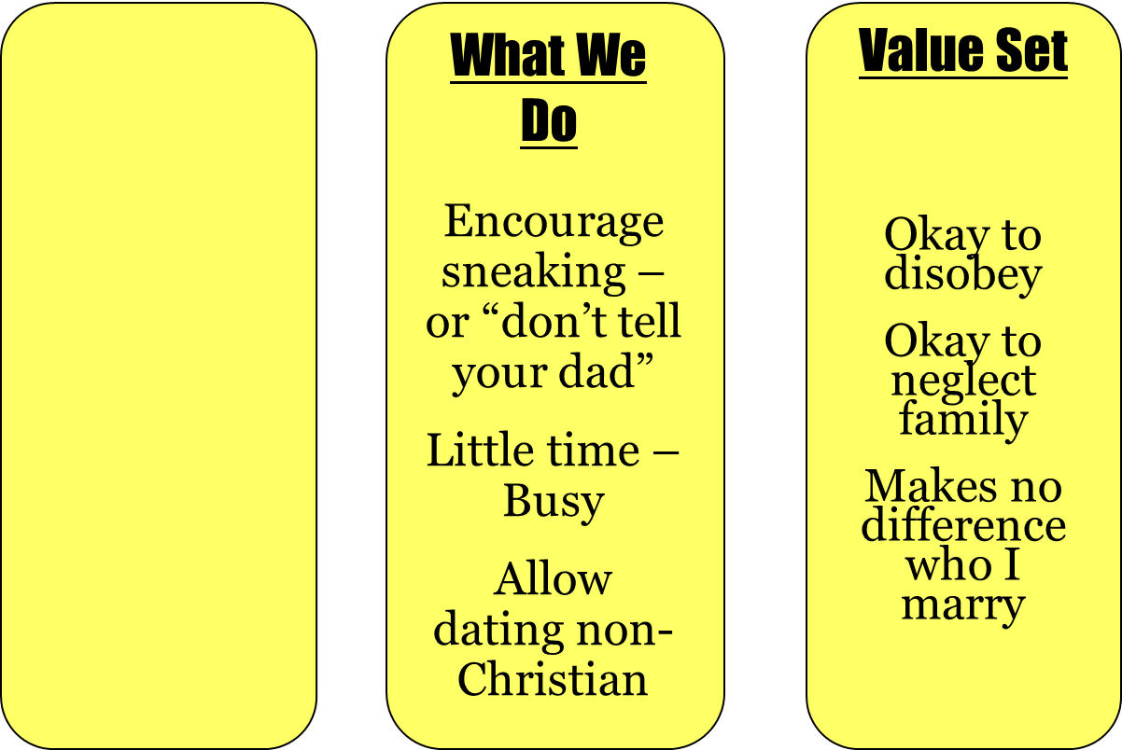
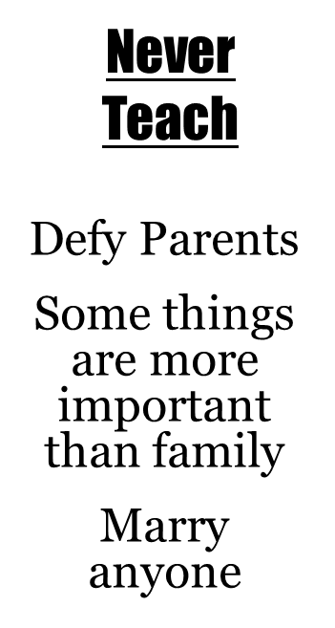

Home & Family

Slide 25
I. The Power of Value Systems
II. The Settings of the Value Systems
III. The Identity of Value Systems

Slide 26
Conclusion:
Set a value system consistent with what you want to teach!

